Slide 1
Demographic Dividend Application in West and Central Africa Latif Dramani University of Thies CREG-CREFAT

Slide 2
Context
**Demographic Growth in Africa is very speed: 2.7 per year , twice more important than the world average which is near 1.2 (AU, 2016)
**More than 25 % of the worldwide population will be adult (UNFPA 2016)
**Basing on the 2045 projections Africa population will be the youngest in the world:
- 400 millions of young people (UNFPA 2016)
**African Youth (15 to 24 years ) : 37% of the population have attained working age (UNFPA 2016)
**60% of unemployed African people are 15 and 24 years old between (UNFPA 2016)
**Youth without professional perspectives can be considered as a lost generation which is a threat to social stability sociale » (ILO 2014)
**Every year, about 10 to 12 millions young people join the labor Marlet (Afrique Expansion, 2016).

Slide 3
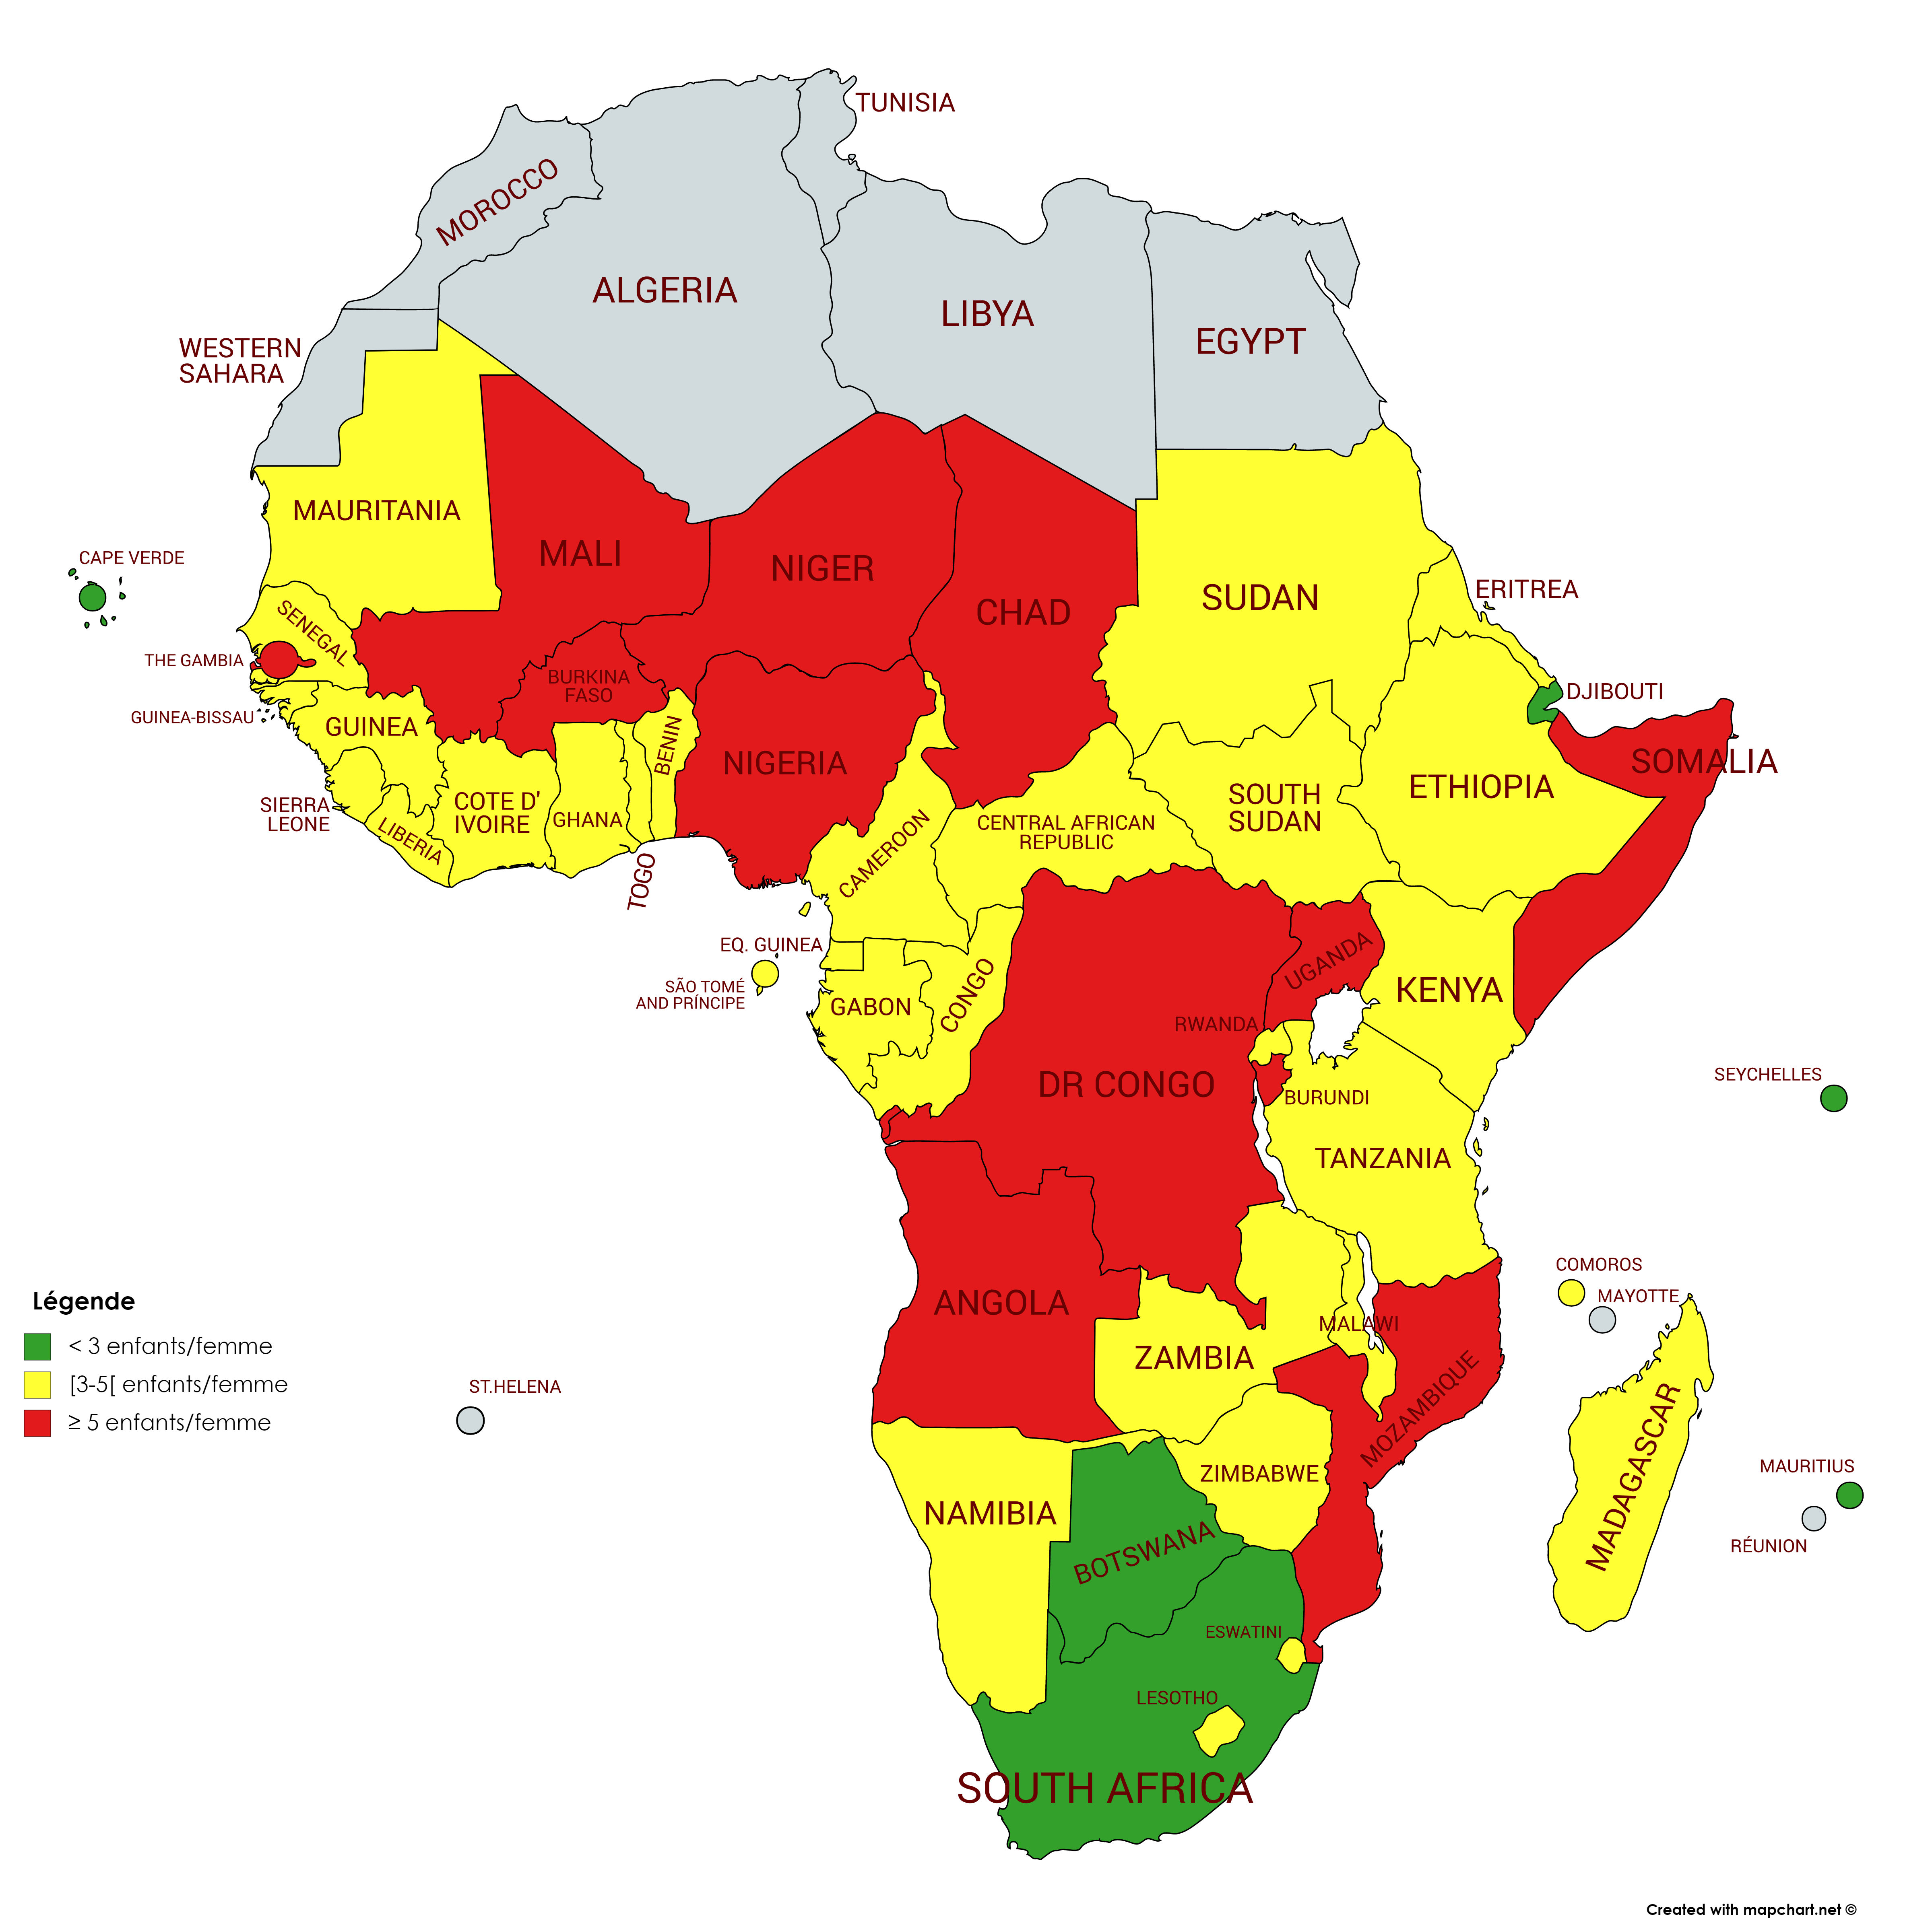
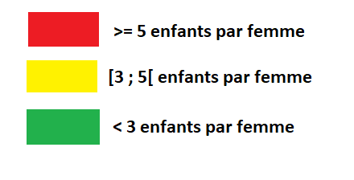
Fertility in Sub-Saharan Africa

Slide 4
» » » Demographic Dividend in west and central africa
nta profiles

Slide 5
National transfer accounts (NTA):
Definition
NTA are a method of measuring how consumption, labour productivity and economic dependence vary with age.
The goal is to improve understanding of how population growth and changing population age structure influence economic growth, gender and generational equity, public finances, and other important features of the macro-economy.
NTA show the age at which individuals become economically independent or dependent again.
They are based on Modigliani's life cycle theory (1954, 1963) and Samuelson's intergenerational models (1958), Diamond (1965)

Slide 6
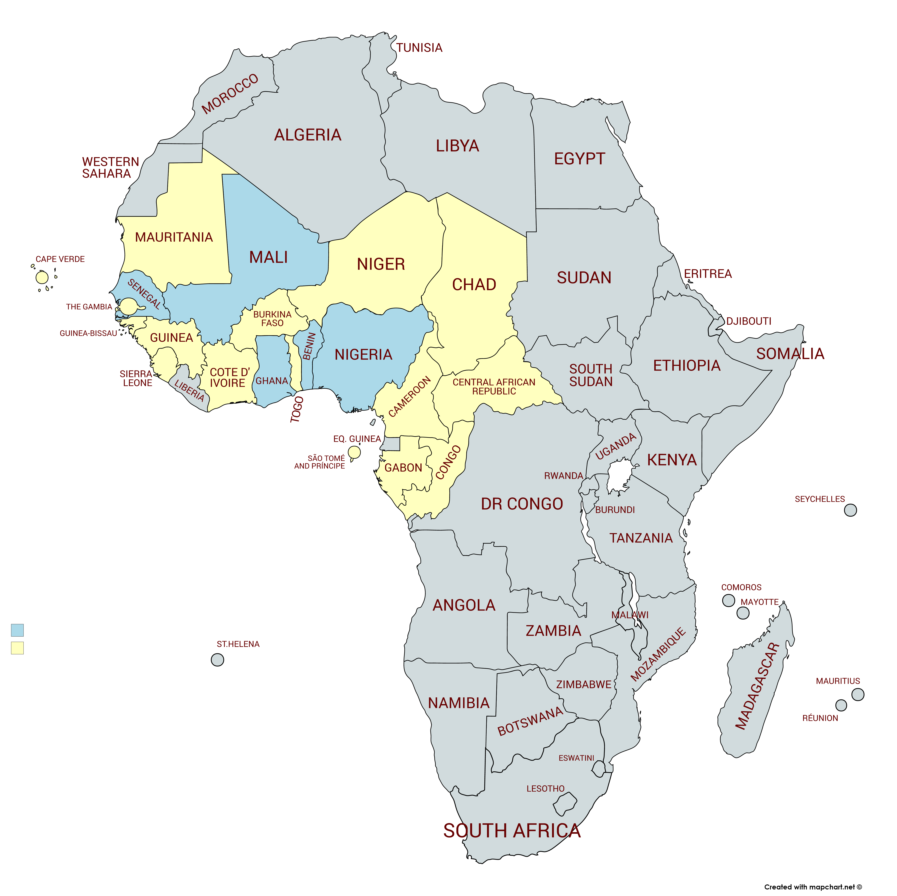
NTA in West and Central Africa

Slide 7
Per capita profiles of Consumption and Labor Income
West and Central Africa (WCA) - Base 2014
Subregions’ profile
WCA’s profile
31 years
CREG-CREFAT 2019

Slide 8
Aggregate profiles of Consumption and Labor Income
West and Central Africa (WCA) - Base 2014
West Africa
Central Africa
Deficit= 10
CREG-CREFAT 2019

Slide 9
» » » Demographic Dividend in west and central africa
Economic support ratio & DD

Slide 10
Economic Support Ratio
𝛾
represents purchasing power of each age group
THE RATIO BETWEEN THE NUMBER OF EFFECTIVE PRODUCERS AND THE NUMBER OF EFFECTIVE CONSUMERS
𝜑
represents the distribution of consumption needs by age
THE GROWTH RATE OF THE SUPPORT RATIO REPRESENTS THE FIRST DEMOGRAPHIC DIVIDEND

Slide 11
Economic Support Ratio in West and Central Africa (WCA), 1950-2100
CREG-CREFAT 2019

Slide 12
Demographic Dividend Profile in West and Central Africa (WCA), 1950-2100
1985
1995
CREG-CREFAT 2019

Slide 13
» » » Perspectives
Projections of the support ratio according to fertility scenarios
Case of the West and Central Africa

Slide 14
Projections of the support ratio
according to fertility scenarii
West Africa
West and Central Africa
CREG-CREFAT 2019

Slide 15
» » » ECONOMIC GAINS
Case of the West and Central Africa

Slide 16
Projections of Support Ratio (SR) and Demographic Dividend (DD)
 | SR_low | SR_med | SR_High |  | DD_low | DD_med | DD_High
Year | West Africa (15 countries) |  |  |  | West Africa
2020 | 41,8% | 41,6% | 41,5% |  | 0,38 | 0,25 | 0,13
2030 | 43,7% | 42,9% | 42,1% |  | 0,66 | 0,46 | 0,26
2040 | 46,9% | 45,1% | 43,4% |  | 0,76 | 0,58 | 0,42
2050 | 50,5% | 47,8% | 45,4% |  | 0,66 | 0,59 | 0,53
 | West and Central Africa (21 countries) |  |  |  | West and Central Africa
2020 | 42,2% | 42,0% | 41,9% |  | 0,44 | 0,31 | 0,18
2030 | 44,4% | 43,6% | 42,7% |  | 0,70 | 0,49 | 0,29
2040 | 47,8% | 45,9% | 44,1% |  | 0,76 | 0,58 | 0,42
2050 | 51,4% | 48,6% | 46,2% |  | 0,64 | 0,57 | 0,51
CREG-CREFAT 2019

Slide 17
Gains of SR and DD
on Economic Growth
Gains in terms of percentage of effective workers |  |  |  |  | Gains in terms of per capita Regional GDP growth
 | SR_low | SR_High | Gains |  | DD_low | DD_High | Gains
Year | West Africa |  |  |  | West Africa
2020 |  | 41,5% |  |  |  | 0,13%
2050 | 50,5% | 45,4% | 5,1% |  | 0,66% | 0,53% | 0,13%
 | West and Central Africa |  |  |  | West and Central Africa
2020 |  | 41,9% |  |  |  | 0,18%
2050 | 51,4% | 46,2% | 5,2% |  | 0,64% | 0,51% | 0,13%
CREG-CREFAT 2019

Slide 18
Policy Implications
Sub-Saharan Africa is well positioned to harness the demographic dividend
To do so, countries must accelerate the demographic transition while controlling population ageing
Implement proactive and structuring policies (labour market, SD and gender and DD-sensitive budgeting)

Slide 19
THANK YOU

